Slide 1
Midterm Project Mangoes level classification

Slide 2
Join the Kaggle competition
Create Kaggle account first
Competition URL:
https://www.kaggle.com/t/d36c876a775e44bb931569a31c2bab2a

Slide 3
Outline
Dataset
Midterm project overview

Slide 4
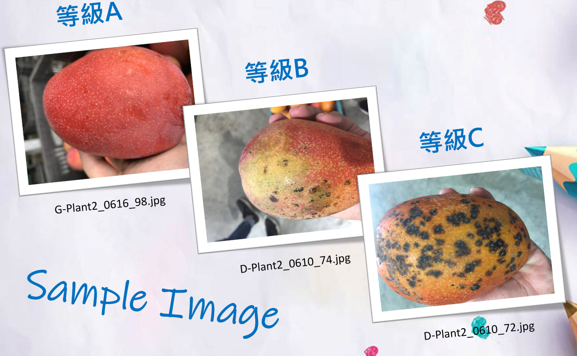
Dataset – Mangoes level classification
Three level of mangoes
A, B, C

Slide 5
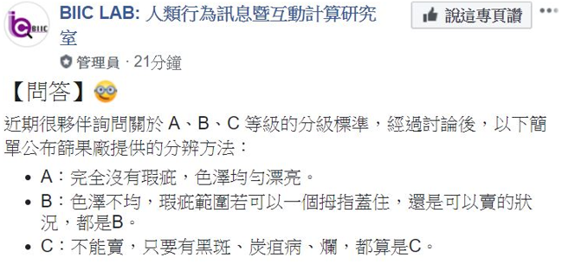
Dataset – Mangoes level classification
Dataset description
Training: 5400
Testing: 800

Slide 6
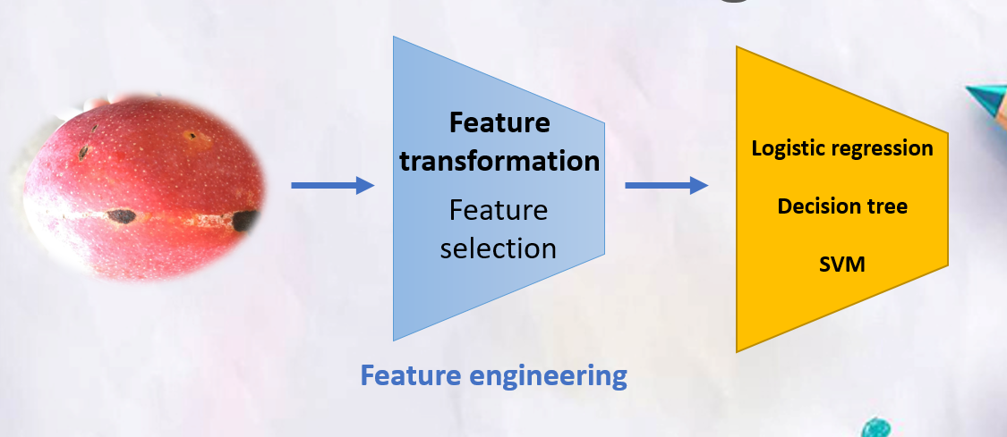
Midterm project overview

Slide 7
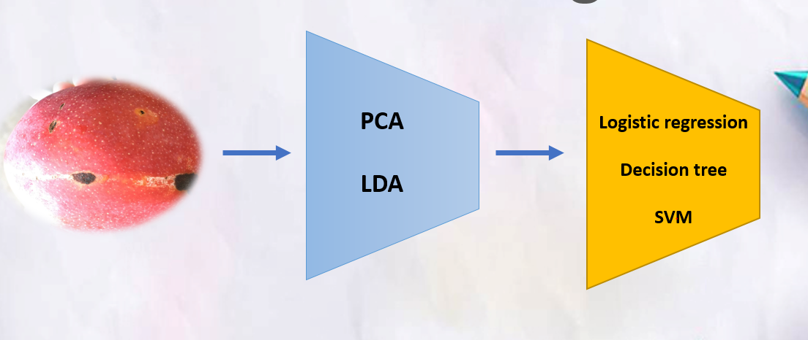
Midterm project overview

Slide 8
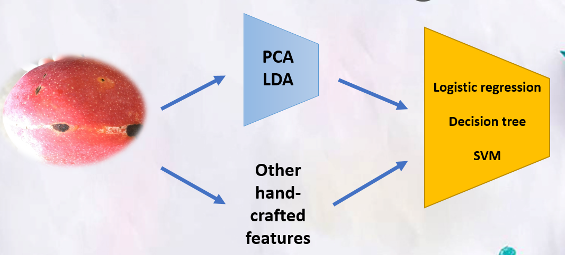
Midterm project overview

Slide 9
Notice
Because the dataset is a little bit large, it’s strongly recommended that you use the subset of the dataset to test your algorithm first.
You can apply any Machine learning methods
CNN method is not allowed
You can use jupyter notebook(.ipynb) or Python script(.py)
You don’t need to use GPU in this lab
You need to download datasets from kaggle
All packages are available
Don’t cheat and don’t guess the answer by yourself
I will run your code

Slide 10
Upload to Kaggle
Write file
Write the prediction to csv file (See samples.csv)
Notice! You should change your prediction to numbers
A -> 0
B -> 1
C -> 2
Evaluation
Categorization accuracy
Upload to Kaggle

Slide 11
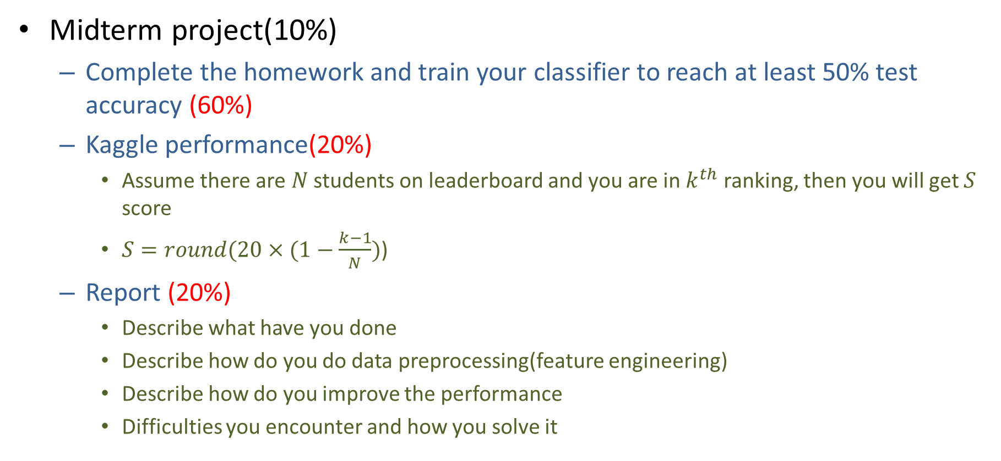
Midterm project Gading policy
Midterm project(10%)
Complete the homework and train your classifier to reach at least 50% test accuracy (60%)
Kaggle performance(20%)
Assume there are $N$ students on leaderboard and you are in $k^{th}$ ranking, then you will get $S$ score
$S=round(20×(1−\frac{k−1}{N})$)
Report (20%)
Describe what have you done
Describe how do you do data preprocessing(feature engineering)
Describe how do you improve the performance
Difficulties you encounter and how you solve it

Slide 12
Reminder
Submit Deadline : 1 month (05/10/2020 11:59 PM)
You need to submit your code to New E3 and upload the result to Kaggle
Hand in your files to new e3
Your code
Readme.txt
Simply explain how to run your code
StudentID_report.pdf

Slide 13
Notice!!!
Change your team name to your ID
If TA can not find your ID, you will loss 20% of score in this lab directly
You only have 10 times maximum daily submissions

Slide 14
Shut down your kernel !!!!!
Remember to SHUTDOWN the kernel
To release resources for others.

